Slide 1


Acme Systems Pty

Slide 2


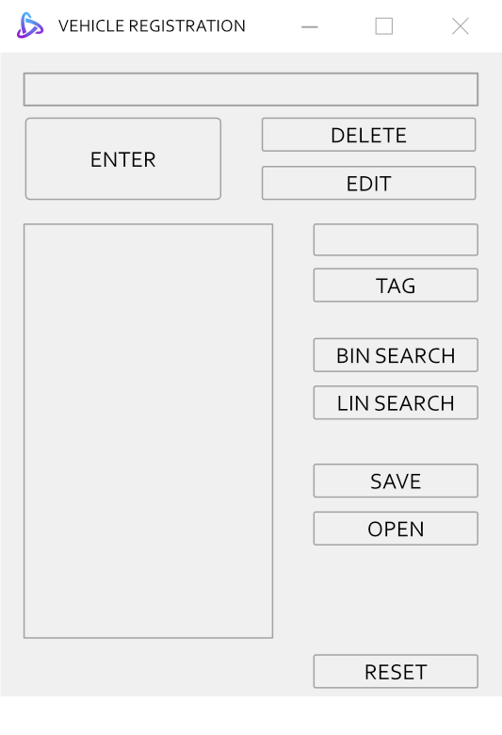
BUTTON LAYOUT
Acme Systems Pty
Notes:
Textbox allows user to enter registration plates
Enter button will add the text contained in the textbox to the list.
Delete button will remove a registration plate from the list
Edit button allows users to replace the registration plate with text from the textbox.
List box contains a list of all registered plates.
Singe display will show the registration plate that was selected from the list.
Tag button enables users to make a mark of a registration plate.
Binary search button enables the user to find a certain registration plate by using the binary search algorithm.
Linear search button enables the user to find a certain registration plate by using the linear search algorithm.
Save button enables the user to save a list of registration plates to a text file.
Open button allows the user to open a text file containing a list of registration plates.
Reset button deletes all registration plates from the list.

Slide 3

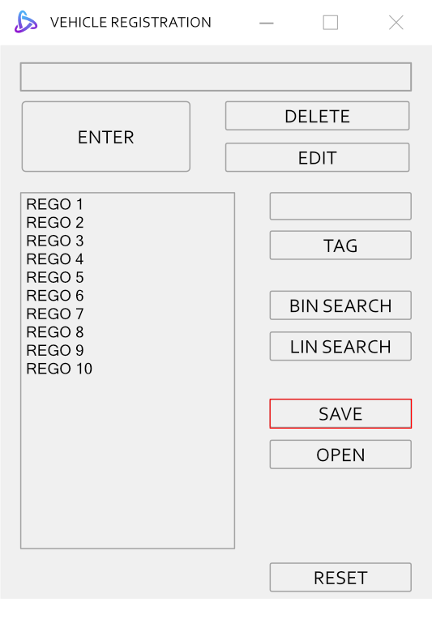

SAVE AND LOAD DATA
Acme Systems Pty
*Click*
Notes:
When the save button is pressed

Slide 4

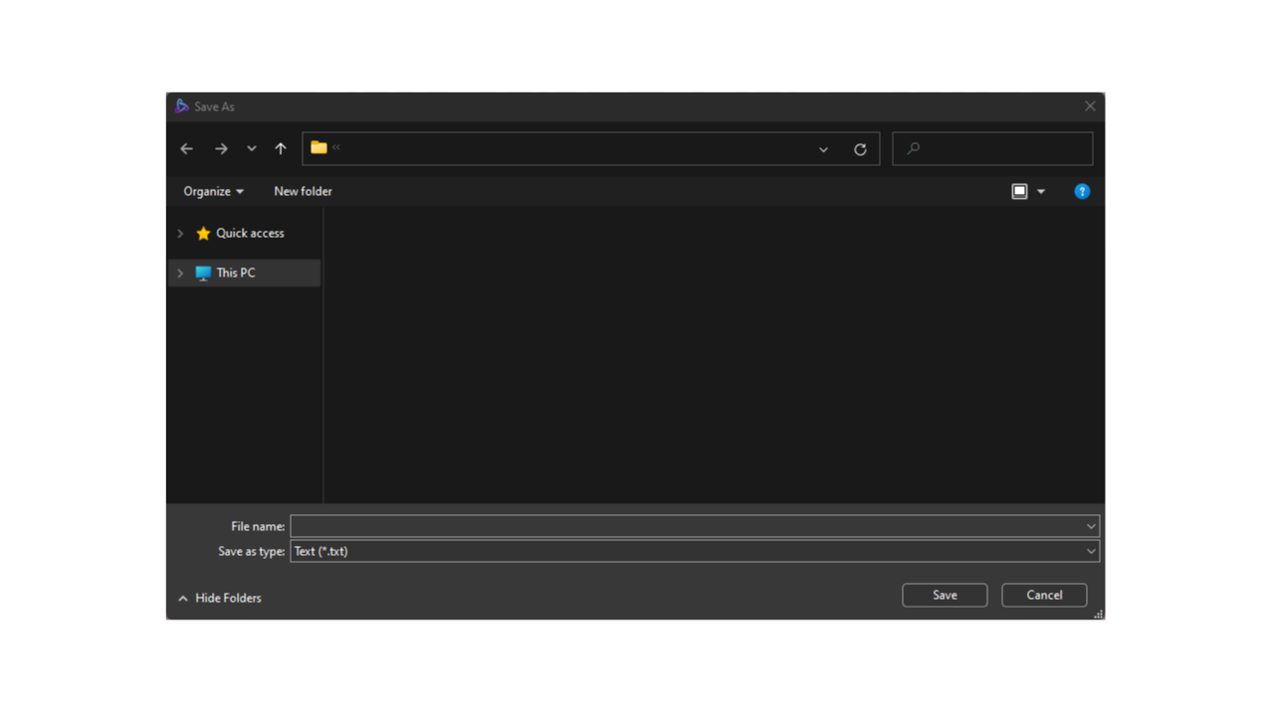
Acme Systems Pty
Save As
Window
Notes:
A save as window appears

Slide 5
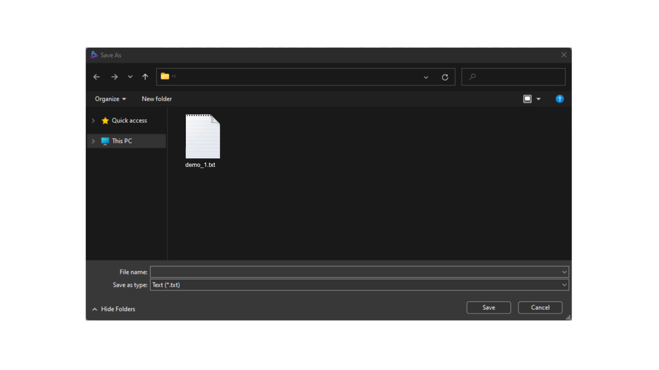
Acme Systems Pty
Save As
Window
Save as a text
Notes:
This enables the user to save the list in text file format, with the filename "demo underscore a number.txt.“.

Slide 6

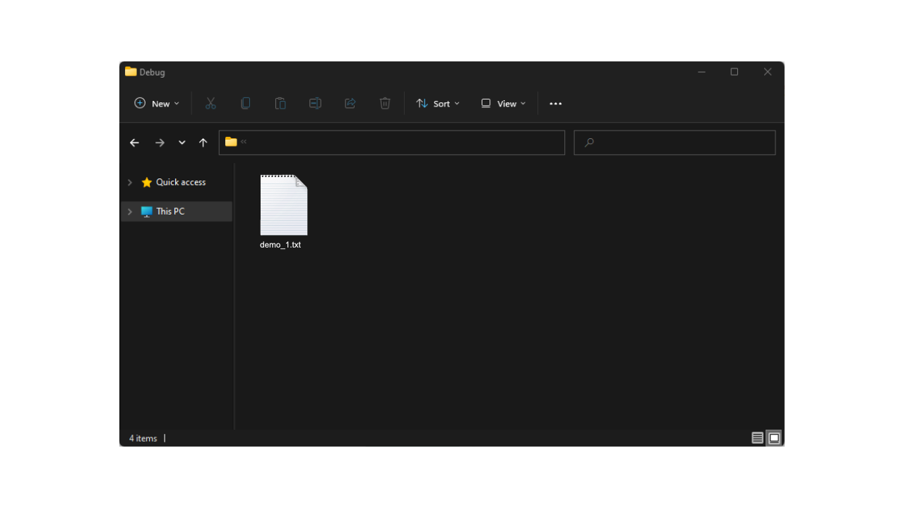
Acme Systems Pty
Notes:
When the program saves the text, it serialises the strings, converting it to a stream of bytes

Slide 7
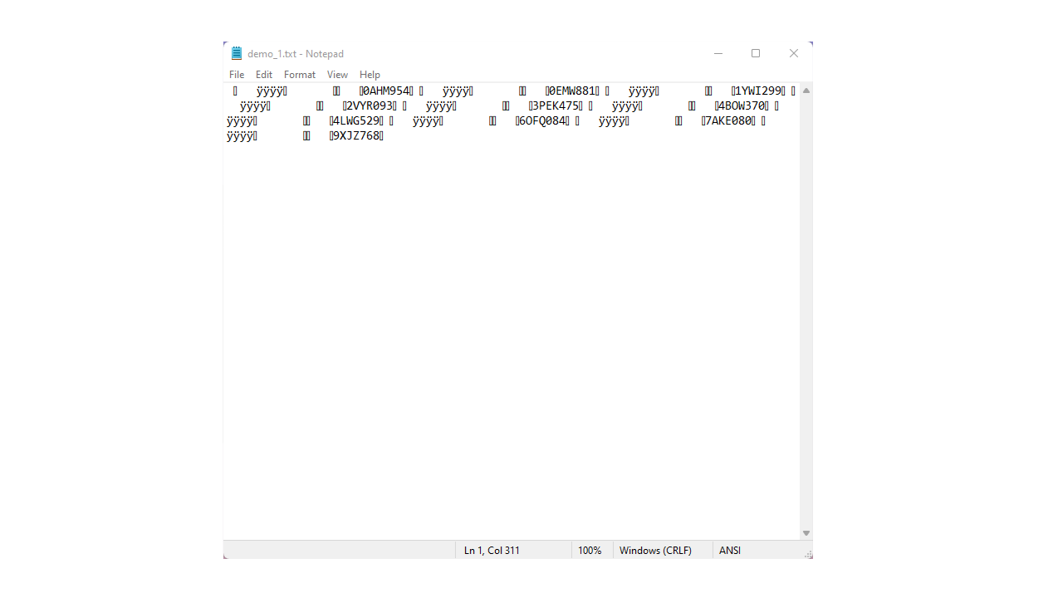
Acme Systems Pty
Notes:
which looks like this

Slide 8

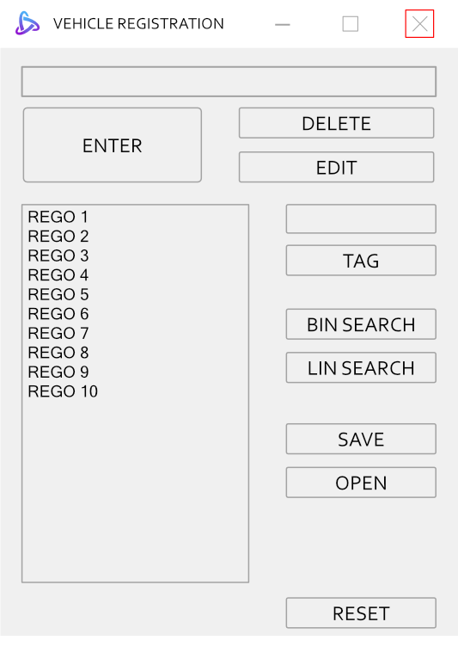
Acme Systems Pty
*Click*
Notes:
Additionally, when the program is closed

Slide 9
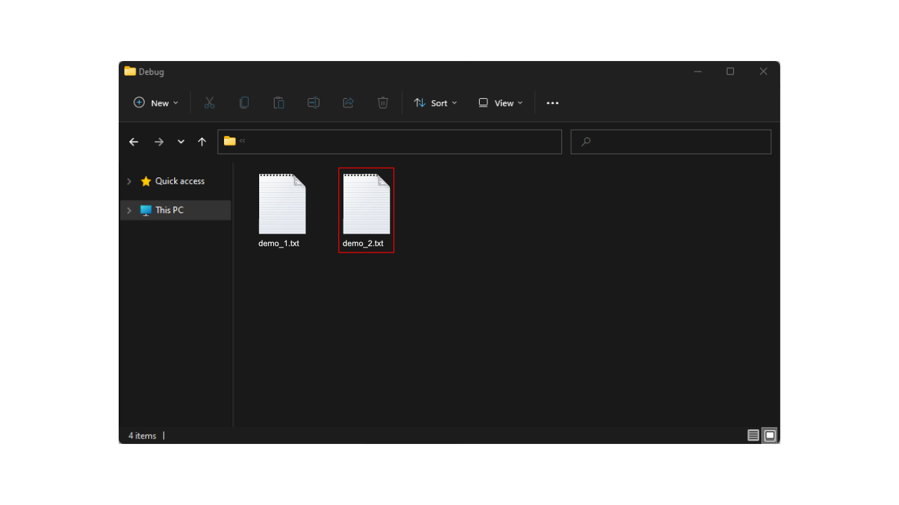
Acme Systems Pty
Notes:
the program creates a text file with the default name "demo underscore number.txt".

Slide 10
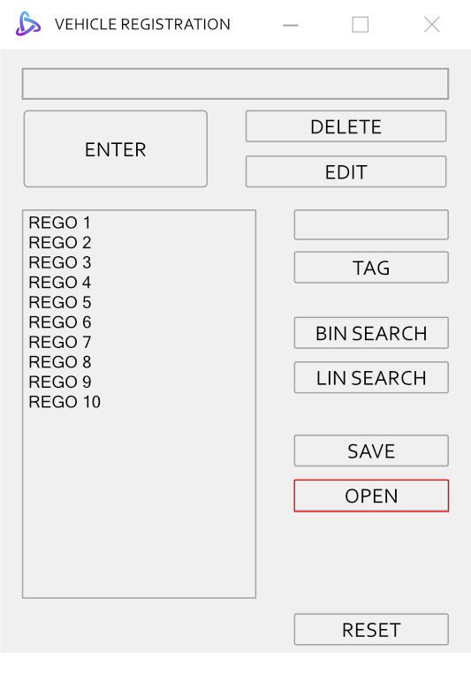
Acme Systems Pty
*Click*
Notes:
Now, when users click the open button

Slide 11
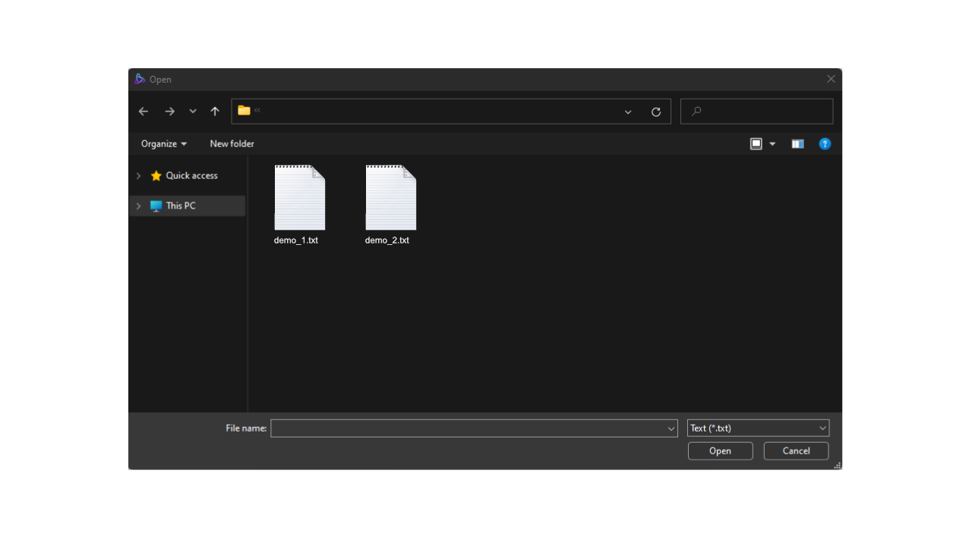
Acme Systems Pty
Open
Window
Notes:
An open window will appear.

Slide 12
Acme Systems Pty
Open
Window
Open text files
Notes:
The program enables the user to open serialised text files.

Slide 13
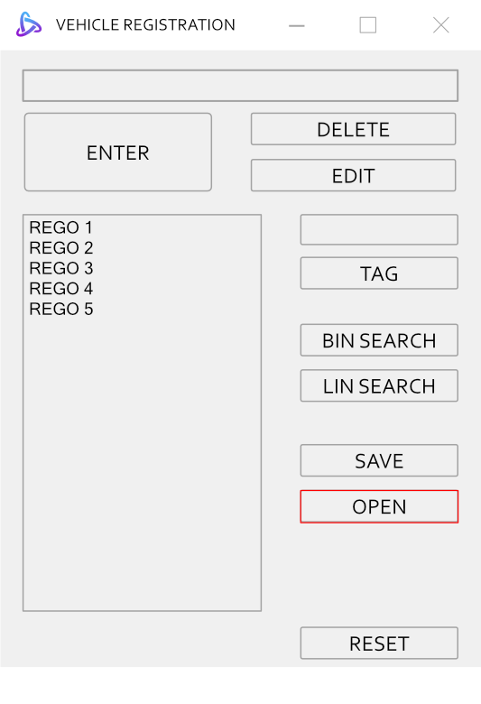
Acme Systems Pty
*DISPLAY*
Open
Window
Open text files
Notes:
The application will then deserialize the text file, which restores the text file to its original format and display the list in the list box.

Slide 14
Acme Systems Pty
Notes:
Additionally, when the program starts

Slide 15

Acme Systems Pty
*Load demo_##.txt by default*
Notes:
The program will automatically open and load the file demo_##.txt.

Slide 16
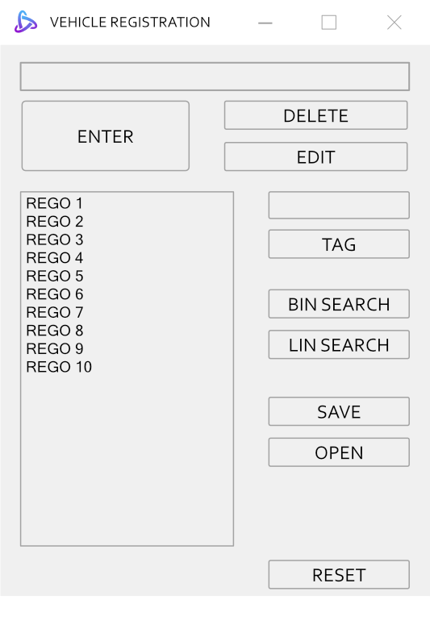
Acme Systems Pty
*DISPLAY*
*Load demo_##.txt by default*
Notes:
and the list box will display the contents of the text file.

Slide 17

UI LAYOUT AND FEATURES
Acme Systems Pty
1. Enter Registration Plate(one number, three letters, three numbers(Standard WA registration plate format))
2. Add Registration Plate to list
3. Remove Selected Registration Plate from the List
4. Change the selected Registration Plate on the list.
5. List of Registration Plates
6. Display Registration Plate
7. Flag a Registration Plate for future inspection
8. Search a particular Registration Plate in binary search method
9. Search a particular Registration Plate in linear search method
10. Save file to text format
11. Open a text file
12. Remove all registration plate in the list
Notes:
The program includes a tooltip that displays the following messages when a cursor hovers over the buttons or the text boxes.

Slide 18
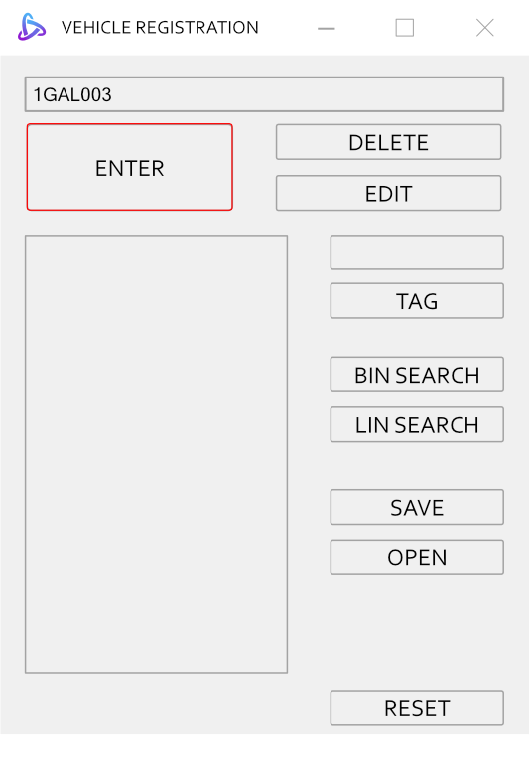
Acme Systems Pty
Notes:
The program features a status strip that displays various notifications/messages based on the user's actions. When a valid registration plate is entered [next]

Slide 19
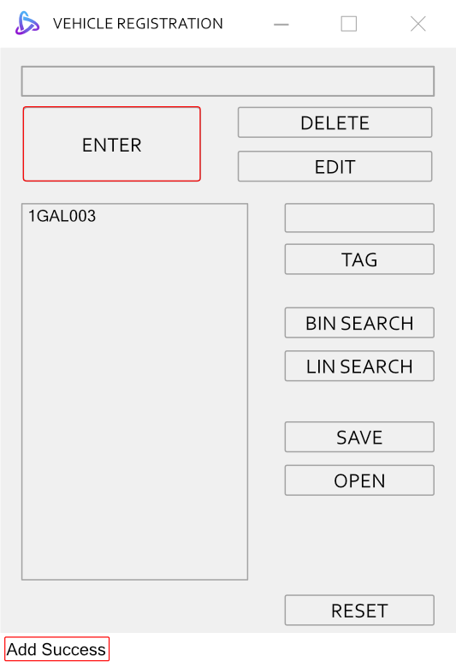
Acme Systems Pty
Notes:
the status strip indicates "add success.“ at the bottom of the program.

Slide 20
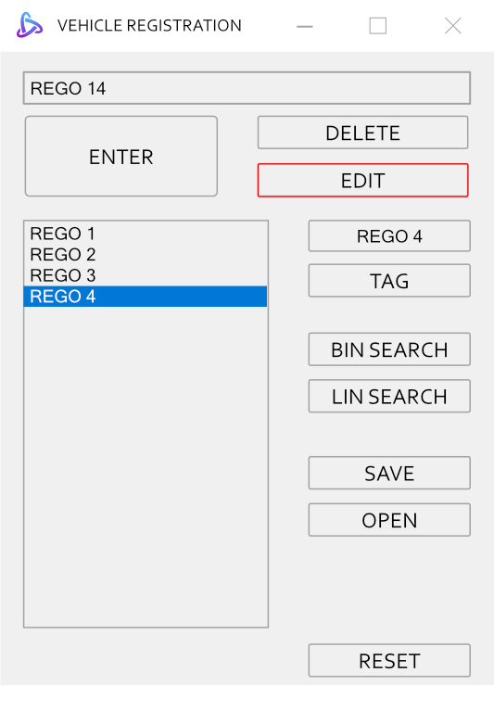
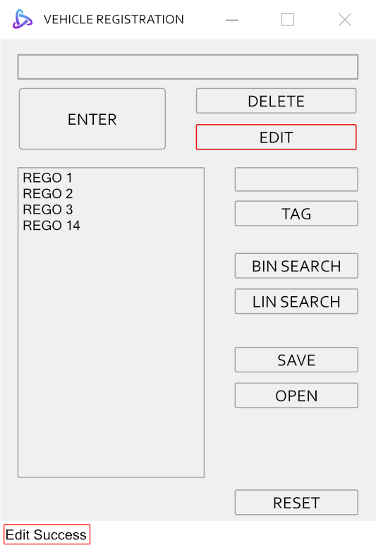
Acme Systems Pty
Notes:
When a registration plate is edited, the status strip indicates “Edit Success”.

Slide 21

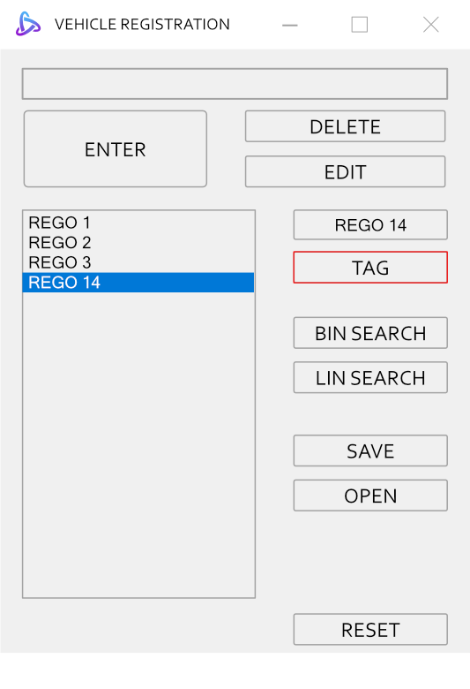
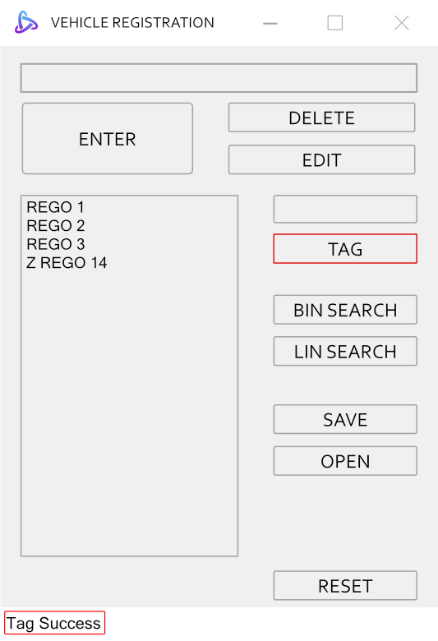
Acme Systems Pty
Notes:
When a registration plate is tagged, the program appends a prefix Z and the status strip will indicate “Tag Success”.

Slide 22
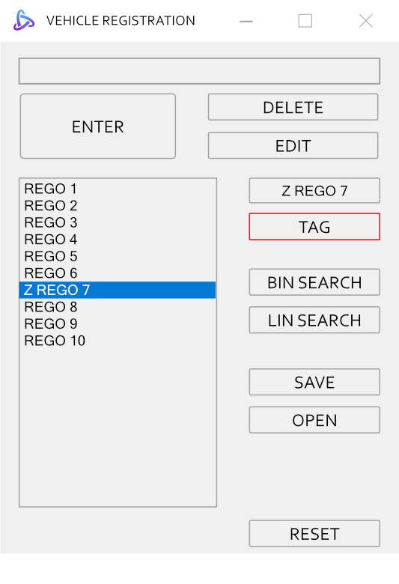
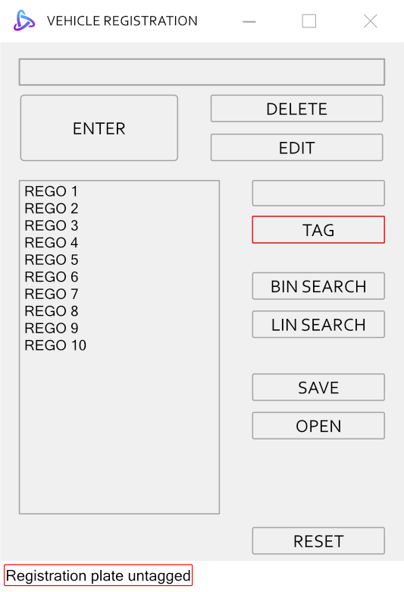
Acme Systems Pty
Notes:
Additionally, when the user selects a tagged registration plate and clicks the tag button, the application will untag the selected registration plate, indicating "Registration plate untagged" in the status strip.

Slide 23
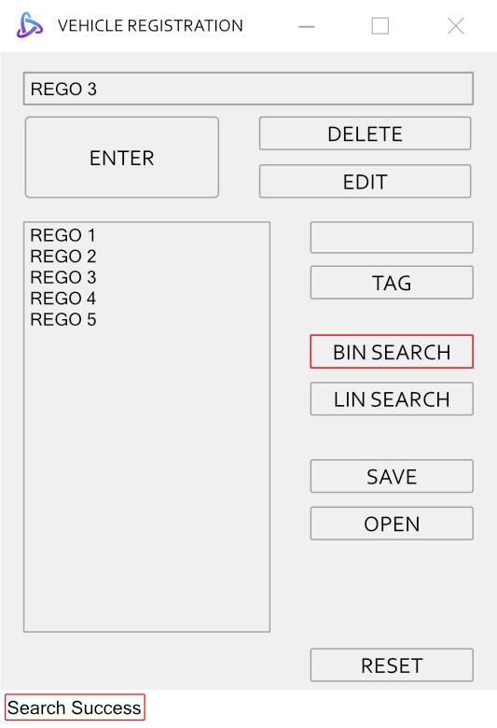
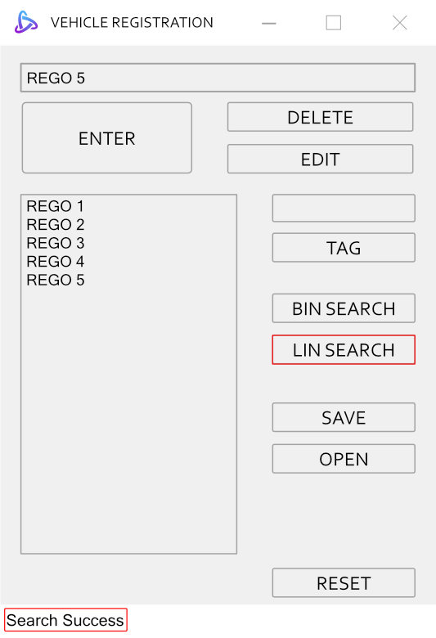
Acme Systems Pty
OR
Notes:
When a registration plate is found using either the binary or linear search buttons, the status strip displays "Search Success."

Slide 24
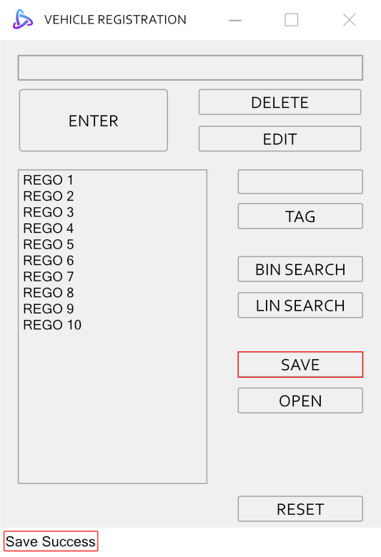
Acme Systems Pty
Notes:
Additionally, when the list is saved, the status strip indicates “Save Success”.

Slide 25
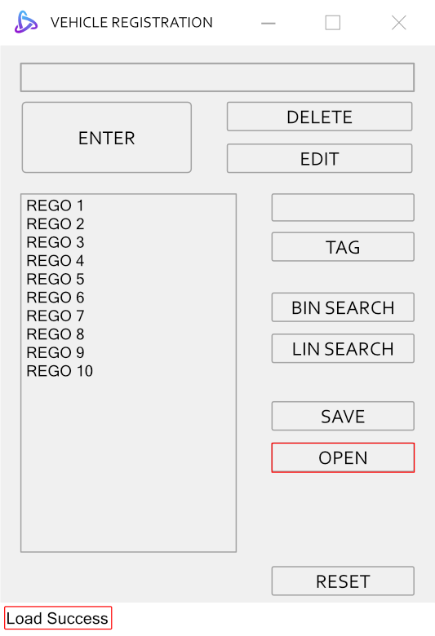
Acme Systems Pty
Notes:
And when a text file is opened, the status strip indicates “Load Success”.

Slide 26
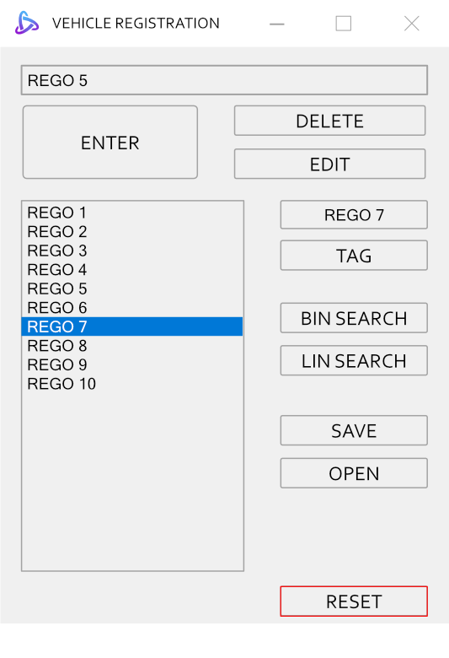
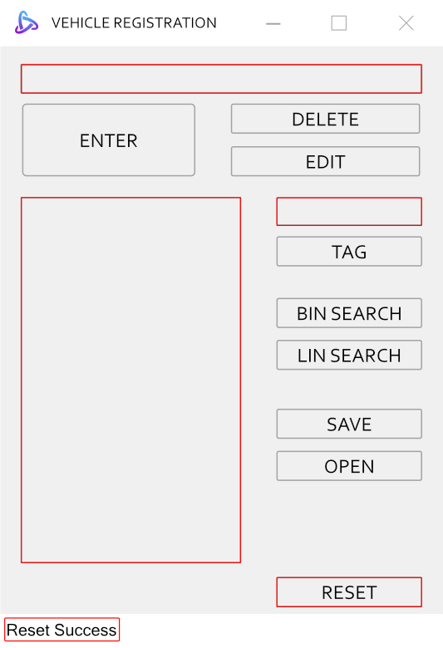
Acme Systems Pty
Notes:
Furthermore, when a list is reset, the contents of the list are erased, the display box and textbox are emptied, and the status strip will indicate "Reset Success."

Slide 27
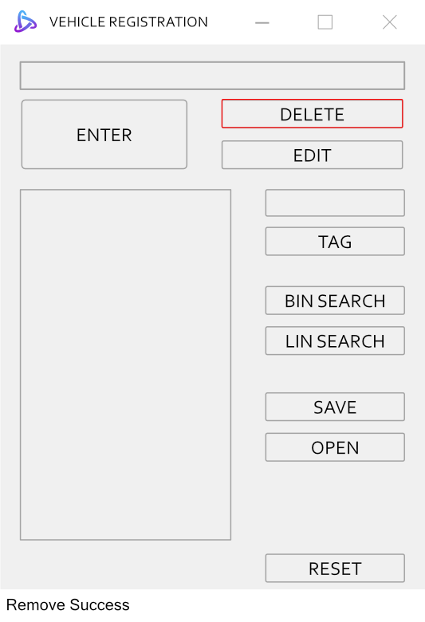
Acme Systems Pty
Notes:
Lastly, When a registration plate is deleted, the status strip indicates “Remove Success”. Additionally, there are two ways to remove a registration plate off the list

Slide 28
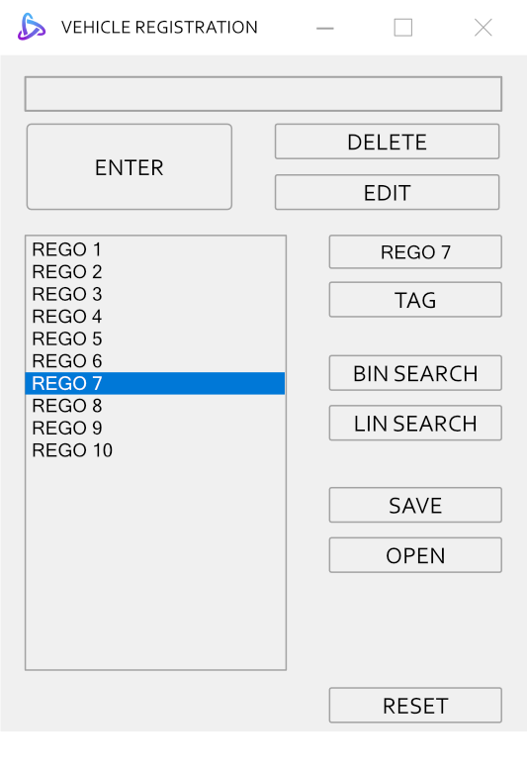
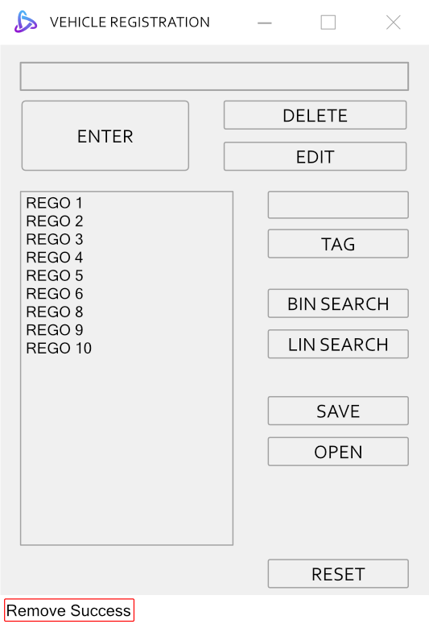
Acme Systems Pty
*Double Click*
Notes:
One way of removing a registration plate is to double click the registration plate from the list.

Slide 29
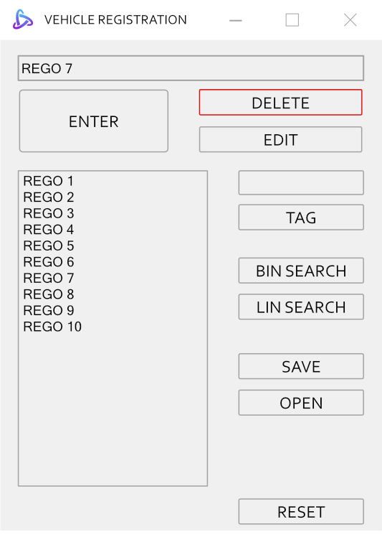
Acme Systems Pty
Notes:
Alternatively, users can delete a registration plate by entering it in the text field and clicking the delete button.

Slide 30
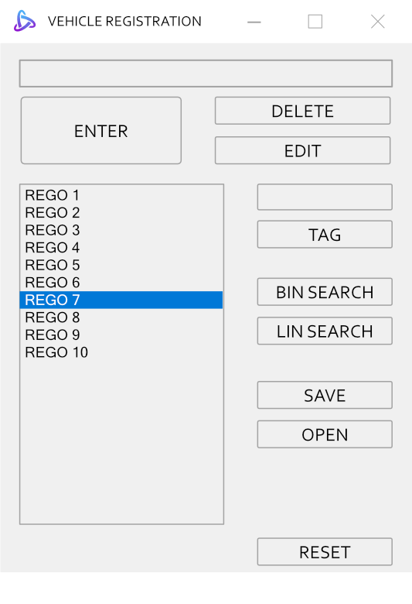
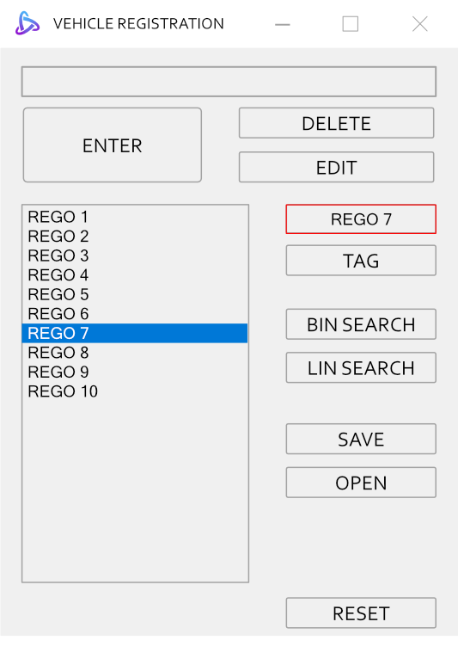
Acme Systems Pty
Notes:
Furthermore, the program includes a select feature that displays a selected registration plate to the text box on the right.

Slide 31
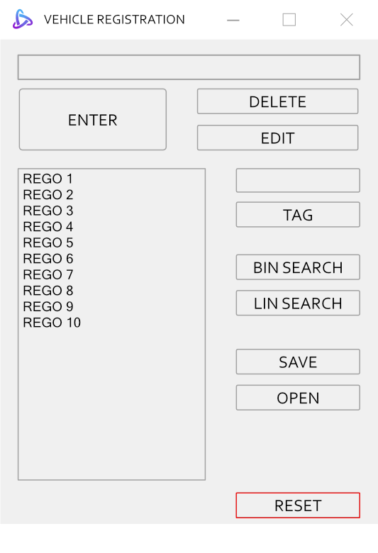
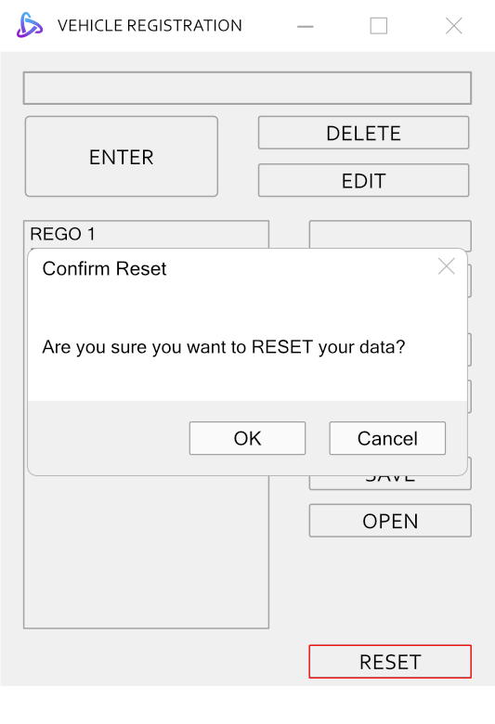
ERROR MESSAGES AND CONFIRMATION NOTIFICATIONS
Acme Systems Pty
Notes:
When the reset button is pressed, a confirmation dialogue box will appear

Slide 32
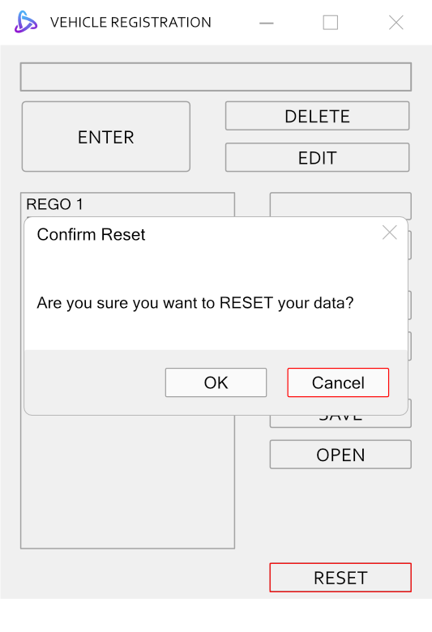
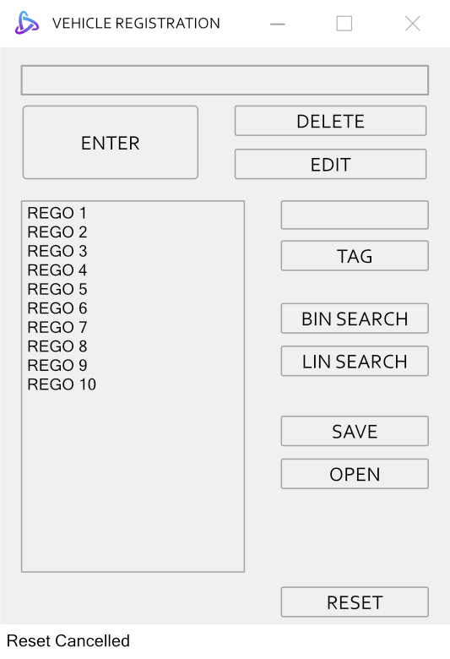
Acme Systems Pty
Notes:
Furthermore, when user click the cancel button, the status strip will display "Reset Cancelled."

Slide 33
Acme Systems Pty
Notes:
There is only one way to add a registration plate to the list, and that is to enter a valid registration plate.

Slide 34
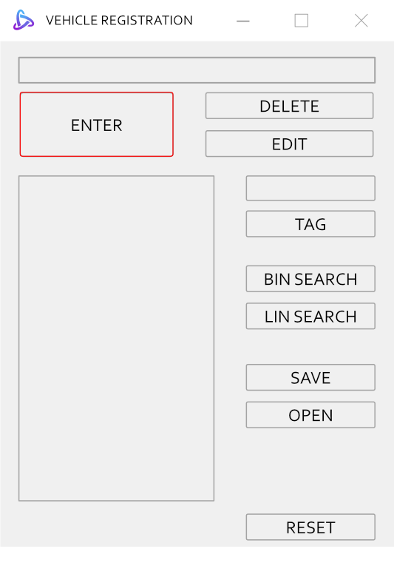
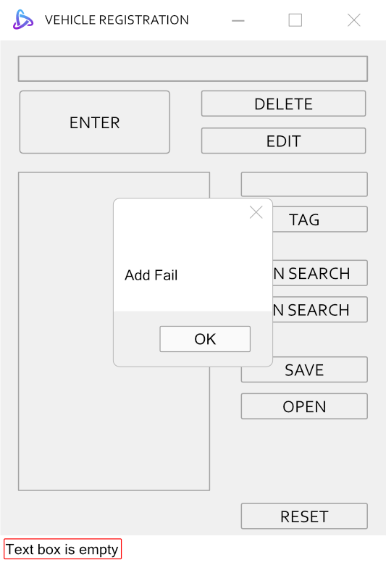
Acme Systems Pty
Notes:
Therefore, when the user enters an empty string, a window stating "add fail" will appear and the status strip will indicate "Text box is empty."

Slide 35

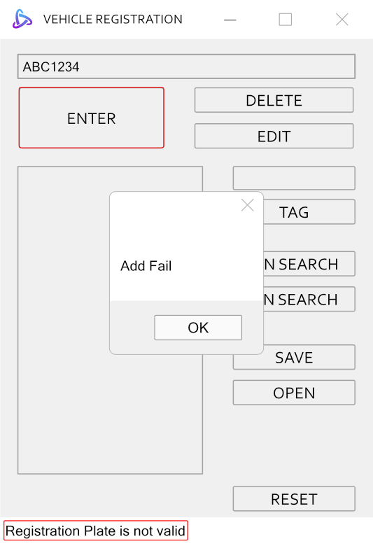
Acme Systems Pty
Notes:
Additionally, when the user enters an invalid registration plate, a window stating "add fail" will appear and the status strip will indicate “Registration Plate is not valid."

Slide 36
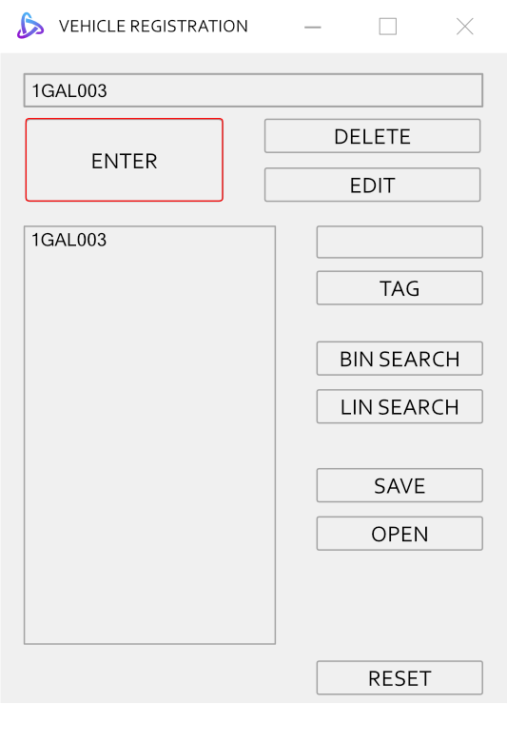
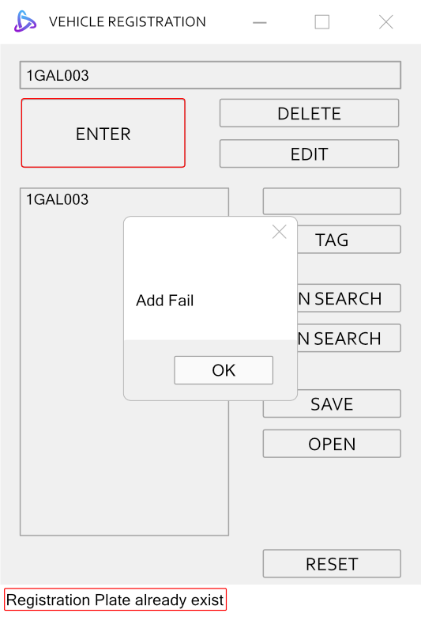
Acme Systems Pty
Notes:
Moreover, when the user enters a registration plate that is already in the list, a window stating "add fail" will appear and the status strip will indicate “Registration Plate already exist."

Slide 37
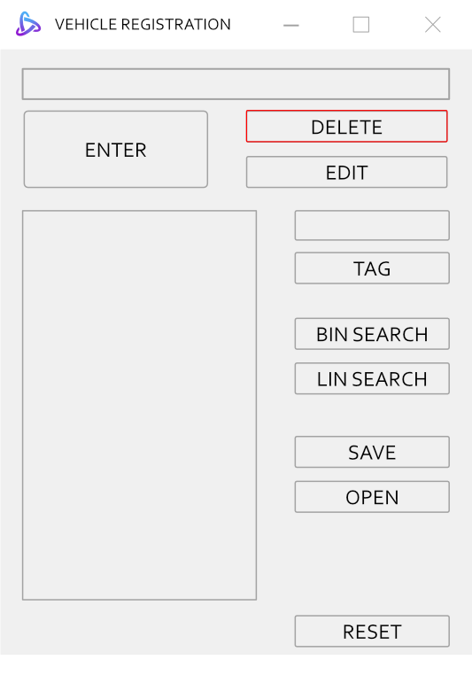
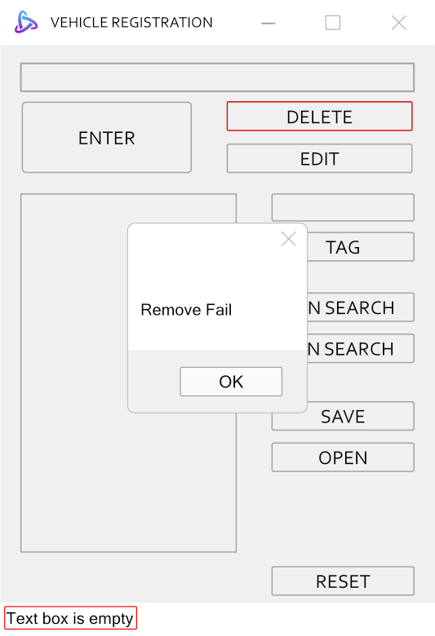
Acme Systems Pty
Notes:
What’s more, when user clicks delete and the text box is empty, a window stating “Remove fail" will appear and the status strip will indicate "Text box is empty."

Slide 38
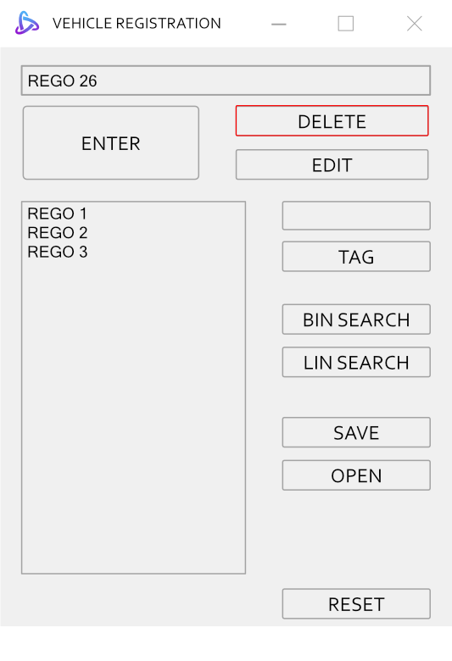
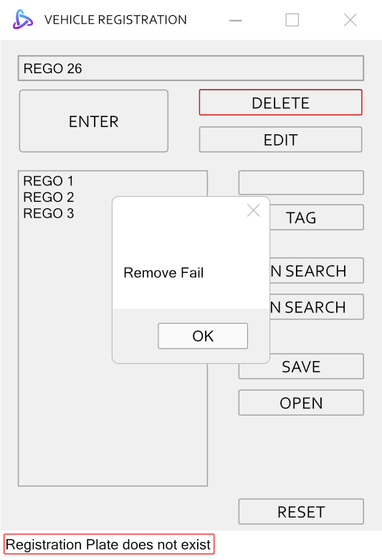
Acme Systems Pty
Notes:
Furthermore, When the user deletes a registration plate that is not on the list, a window stating “Remove fail" will appear and the status strip will indicate "Registration Plate does not exist"

Slide 39
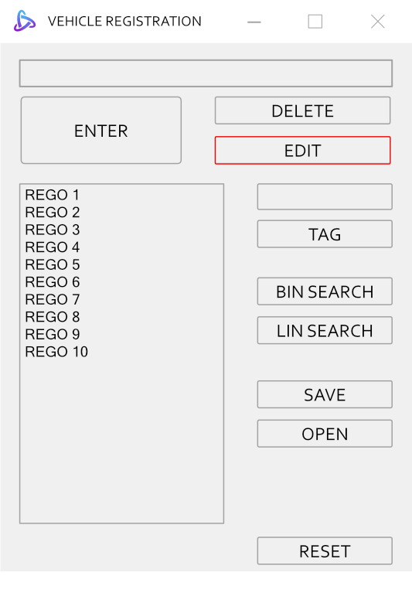
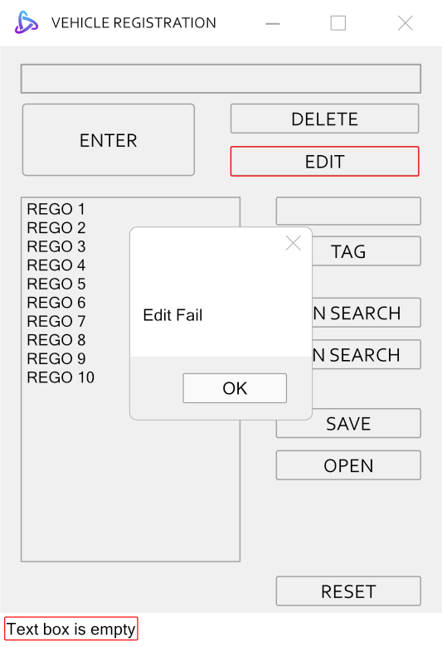
Acme Systems Pty
Notes:
Moreover, when the user clicks edit when the text box is empty, a window stating “Edit Fail" will appear and the status strip will indicate “Text box is empty“

Slide 40
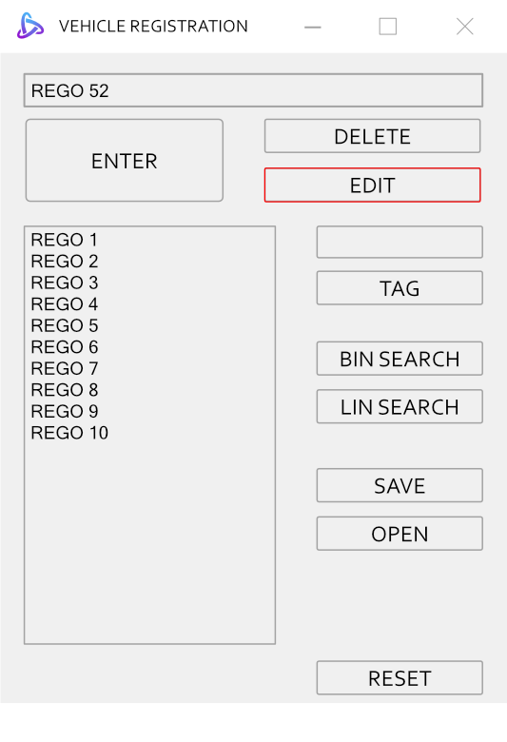
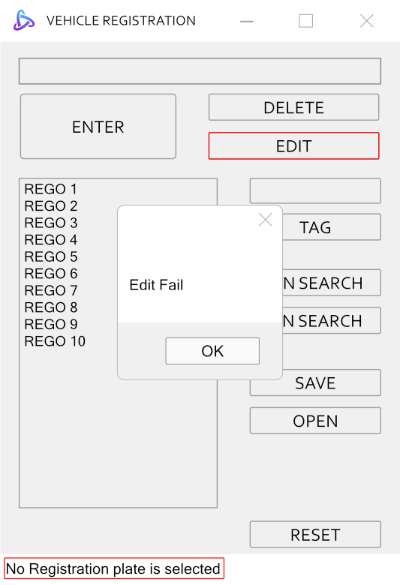
Acme Systems Pty
Notes:
Furthermore, when the user clicks edit without selecting a registration plate, a dialogue box with a message "Edit Fail" will appear and the status strip will indicate “No Registration plate is selected"

Slide 41
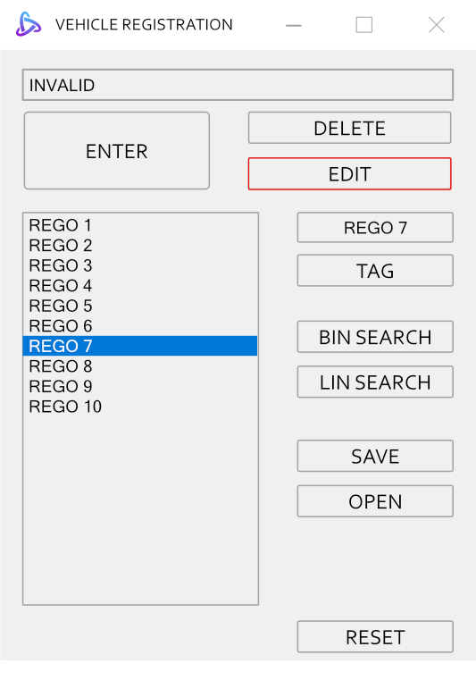

Acme Systems Pty
Notes:
Additionally, when the user clicks edit while the text box contains an invalid registration plate, a dialogue box with a message "Edit Fail" will appear and the status strip will indicate “Registration Plate is not valid"

Slide 42


Acme Systems Pty
Notes:
Lastly, when an existing registration plate is entered into the text box and the user clicks the edit button, a dialogue box with a message "Edit Fail" will appear and the status strip will indicate “Registration Plate already exist"

Slide 43


Acme Systems Pty
OR
Notes:
When the user performs a binary or linear search for an empty string

Slide 44


Acme Systems Pty
OR
Notes:
A dialogue box with a message “Search Fail" will appear and the status strip will indicate “Text box is empty"

Slide 45


Acme Systems Pty
OR
Notes:
Additionally, if the user conducts a binary or linear search for a registration plate that is not in the list

Slide 46


Acme Systems Pty
OR
Notes:
A dialogue box with a message “Search Fail" will appear and the status strip will indicate “Registration Plate does not exist"

Slide 47




Acme Systems Pty
OR
Notes:
When the user clicks the save or open button and then cancels the action

Slide 48


Acme Systems Pty
OR
Notes:
The status strip will indicate “Save Cancelled “ or “Load Cancelled”.

Slide 49
QUESTIONS
Acme Systems Pty

